Slide 1
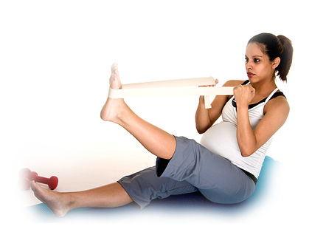
Changes in Pregnancy
Notes:
NOTE: Refer to module outline for goal, objectives, class outline, equipment, resources required and references.
If this is the first class:
Welcome participants to class.
Housekeeping: bathroom, breaks, length of session, ground rules/respect.
Have participants introduce themselves (name, due date, HCP, anything they would like to share about the pregnancy).
Provide an outline of topics to be discussed.
Provide the choice of prenatal handout (depending on your organization, this may be Healthy Beginnings or A Healthy Start for Baby and Me) for each expectant mother.
Provide a list of community resources.
Suggestion: on a flip chart, list the topics to be discussed in this session.
Pregnancy Time Lines
Baby’s Growth and Development
Common Discomforts
Emotional Changes
Partner Adjustments
Additional Resources

Slide 2
Pregnancy is a Time of Change
Notes:
Pregnancy is a time of change for everyone - mother, baby, partner and relationships. From the time of conception to the delivery of your baby, your body will go through an exciting transformation. Your baby will grow from two single cells into a unique little person with her own distinct personality and characteristics. From the time of conception, her eye colour, hair colour, height, and general temperament are predetermined.
In this session, we will review pregnancy timelines, how your baby grows, some common physical discomforts and emotional changes, partner adjustments, and where to get help in your community.

Slide 3
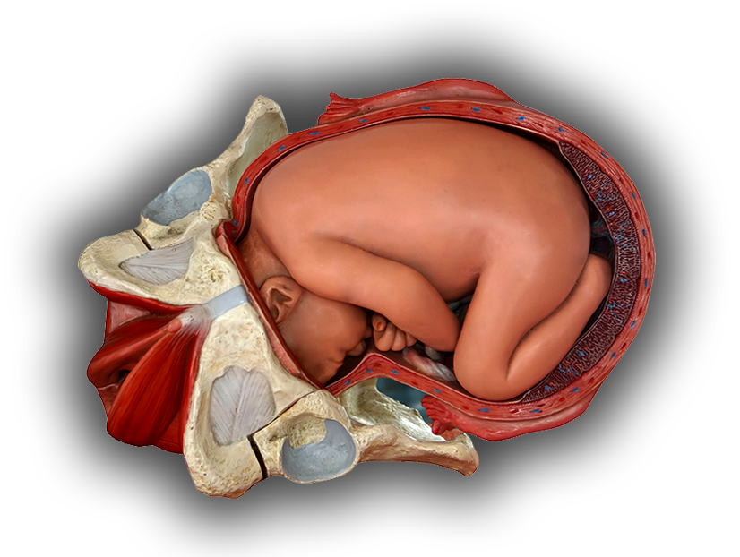
You and Your Baby
Notes:
During your pregnancy, you will be hearing a great deal of new terms, such as placenta, cervix, and amniotic fluid. Here is an inside look at the environment your baby is growing in.
Your baby is growing inside your uterus. This muscular pear-shaped organ stretches throughout pregnancy (show charts) to accommodate your growing baby. The top part of the uterus is called the fundus and the lower part is called the cervix. The cervix will thin and open during labour. When you are fully dilated (10 cm), you will likely have the urge to push the baby through the vagina (unless you have an epidural), which is also called the birth canal. Your health care provider will support you through this process.
Along with your baby, your uterus contains the placenta and amniotic sac. The amniotic sac, also known as the bag of waters, is a membrane that surrounds your baby and it contains the amniotic fluid. By the end of the pregnancy, there are over two cups of amniotic fluid surrounding the baby. The fluid helps to regulate baby’s temperature, acts as a shock absorber, and facilitates his movement. Did you know that the baby also practices “breathing” the amniotic fluid in and out of his lungs which helps them to develop? Or, that the amniotic fluid is completely replaced every few hours? The baby swallows the fluid and also excretes sterile urine into it.
The placenta is an organ that develops during pregnancy and it usually attaches to the upper wall of the uterus. It is connected to your baby by the umbilical cord. The placenta produces hormones and transfers oxygen and nutrients to your baby and removes waste products from your baby. Unfortunately, the placenta does not act as a barrier to alcohol, tobacco, drugs and other substances. Following the birth of your baby, the placenta is delivered.
Suggestions for Facilitator
Use the Growing Uterus (Schuchardt) charts to further explain the differences between a non-pregnant and full-term pregnant woman. Highlight the physiological differences mentioned above.

Slide 4
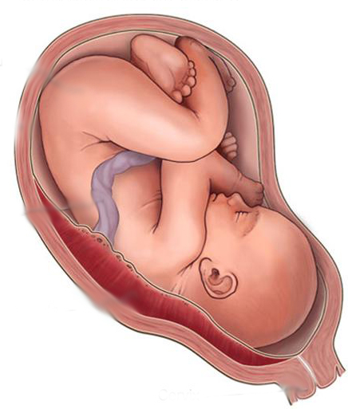
Pregnancy Time Lines
1st Trimester (Weeks 1-12)
1st Month
2nd Month
3rd Month
2nd Trimester (Weeks 13-28)
4th Month
5th Month
6th Month
3rd Trimester (Weeks 29-40)
7th Month
8th Month
9th Month
Notes:
How long does pregnancy last? Are you confused by the weeks, months, and trimesters?
Let’s start with how your due date is calculated. Pregnancy usually lasts 40 weeks or 280 days from the first day of your last period. To figure out your due date, count nine calendar months plus seven days from the first day of your last menstrual period. Only about 4% of babies are born on their actual due dates, while about 85% are born a week before or after (usually after).
If you want to determine your due date, you can go to the Society of Obstetricians and Gynaecologists website at www.sogc.org and search “due date calculator”.
An ultrasound may also change the due date as it helps assess the baby’s actual size.
Each pregnancy has three parts and each part is called a trimester. Each trimester is about three months long.

Slide 5
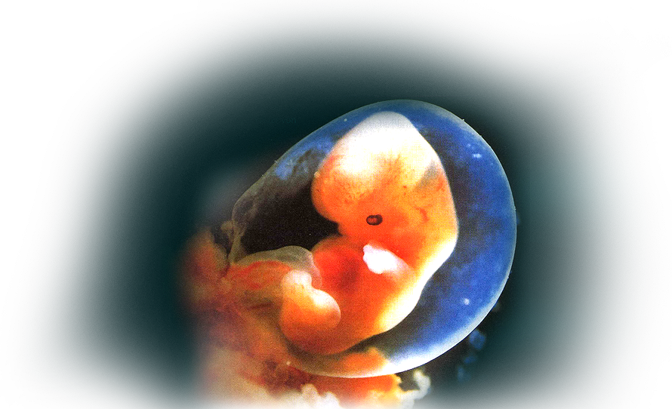
Your Growing Baby (1-12 weeks)
Notes:
By the end of the first trimester, your baby is about 3-4 inches long and weighs about an ounce. An ounce is about the weight of a slice of bread.
In these short weeks, your baby’s brain and spine are developing, his face and limbs are forming, and his arms and legs are moving.
Did you know that his heart is already beating and his sex is determined? Your health care provider can hear the baby’s heart through a Doptone, which is a hand-held, portable ultrasound tool used for fetal monitoring.

Slide 6
Your Growing Baby (13-28 weeks)
Notes:
By the end of the second trimester, your baby is 14 inches long and weighs two pounds. Imagine holding two pounds of butter or a two pound hand weight.
During this time, your healthcare provider can hear your baby’s heartbeat and you will start to feel your baby move.
Your baby can suck her thumb and hiccup and she can open her eyes. Her teeth are already developing inside her gums.

Slide 7
Your Growing Baby (29-40 weeks)
Notes:
By the end of the third trimester, your baby is 20 inches long and weighs about 7.5 pounds.
During these final weeks of fetal development, your baby can hear your voice and other sounds. This is a great time to read stories, talk or sing to him.
His skin becomes less wrinkled as he gains more weight.
He may be less active because there is less room to move inside the uterus. He is likely to get into a head down position in preparation for labour and birth, usually after 34 or 35 weeks of pregnancy.

Slide 8
Video Clip
Notes:
Show a short (e.g., 5 minute) video clip of fetal development (i.e. Healthy Journey: Your Contemporary Guide to Pregnancy—Roadmap of Pregnancy segment)

Slide 9
Jessica and Mike
Notes:
Mike and Jessica are expecting their first baby. Jessica has been feeling tired and a bit irritable lately. She has been trying to eat properly but finds eating in the morning upsets her stomach. Mike is excited about being a dad but concerned about Jessica’s lack of energy and mood swings. Mike is wondering if it will be like this the whole pregnancy. Should they be concerned?
Jessica and Mike should not be concerned because pregnancy is a time of change. Symptoms such as nausea and vomiting, moodiness, and fatigue are common in pregnancy and there are often things you can do to help alleviate them. Be sure to mention any discomforts or changes to your healthcare provider.
Suggested Activity:
Have pregnant women and partners separate into two groups. Ask participants these questions and have someone record and report answers.
List the top 3 best and top 3 worst changes you have noticed during pregnancy.
OR
Pregnant women list the top 3 worst changes they have noticed during pregnancy and the partners list the top 3 best changes they have noticed.

Slide 10
What is Happening to Me?
Key hormones:
Human chorionic gonadotropin (hCG)
Progesterone
Estrogen
Relaxin
Oxytocin
Notes:
At times it feels like your body is not your own. Changing hormone levels are responsible for many of the physical and emotional changes that occur during pregnancy. Let’s talk about some of reasons why you may feel the way you feel.
Human chorionic gonadotropin (hCG) is also called the « pregnancy hormone ». It is the one which indicates pregnancy in early pregnancy tests. It is also the one which causes nausea.
Progesterone is the most important hormone in pregnancy. Heartburn, acid reflux, and indigestion are related to high levels of which relaxes the stomach and bowels to increase absorption of nutrients. This hormone relaxes the uterus and prevents it from contracting too much during pregnancy. It is also the hormone which causes shortness of breath.
Estrogen is the hormone responsible for making the uterus grow and increasing its blood supply throughout pregnancy. It also increases vaginal mucous production and stimulates the development of breast ducts in preparation for breastfeeding.
Relaxin is the hormone that relaxes and softens ligaments and cartilage in the body during pregnancy, including the cervix. It is responsible for expansion of the pelvic joints during labour and delivery.
Oxytocin causes the uterus to contract during labour and it is also responsible for the milk let-down reflex for breastfeeding.
By the end of your pregnancy your blood volume will increase by 30-50% to support your growing placenta. As a result your heart rate increases by 10-15 beats per minute to provide additional oxygen and nutrients to your baby. Your body requires more oxygen so you will notice that you breathe faster and deeper and may feel breathless at times.

Slide 11
Common Changes - First Trimester
Notes:
One of the most common discomforts of early pregnancy is nausea and vomiting. Also known as morning sickness, it can occur at any time of the day. It usually occurs between seven and twelve weeks of pregnancy and subsides by sixteen weeks. Nausea is related to the increased production of pregnancy hormones. Once your body adjusts to the new levels, your nausea subsides. Up to 80% of pregnant women experience some degree of nausea and vomiting. Twenty percent of women will experience these symptoms for a longer period of time. It is important to talk to your health care provider for tips about managing nausea and vomiting. For severe cases of nausea, there is medication which is safe to use during pregnancy.
Some helpful tips include:
Eating a few crackers or dry toast.
Getting out of bed slowly.
Eating small meals or snacks frequently so your stomach does not feel empty.
Eating foods that appeal to you.
Avoiding spicy, fried, or fatty foods.
Avoiding strong odours.
Drinking small amounts of fluid during the day and avoid drinking fluids during meals.
Using acupressure wristbands marketed for motion sickness.
Making sure you get enough sleep.
Getting help and support from friends and family.
Additional information is available at Motherisk (www.motherisk.org/women/morningSickness.jsp) .
11

Slide 12
Common Changes - First Trimester
Notes:
During the first few months of pregnancy, you may feel very tired. Do not worry-it’s normal to feel this way. The increased levels of progesterone (a pregnancy hormone) makes women feel more sleepy. Furthermore, a pregnant woman’s metabolism increases and this consumes a lot more of her energy.
Some helpful tips include:
Pay attention to your body and rest when you are tired.
Take naps during the day.
Accept help from family and friends.
Eat small amounts of food many times during the day.

Slide 13
Common Changes - First Trimester
Notes:
Have you found yourself going to the bathroom more often lately? During pregnancy your growing uterus puts pressure on your bladder, while at the same time, your kidneys are producing more urine.
Some helpful tips include:
Drink less in the evening.
Go to the bathroom every time you have an urge to urinate.
Make sure your bladder empties completely.
Try Kegel exercises.
Kegel exercises provide strength training for the muscles that surround your pelvic floor. Doing a series of Kegel exercises several times a day will strengthen the muscles that stretch during childbirth and may prevent stress incontinence (urine leaking when you cough, sneeze, or laugh). These exercises can be done in any position. To do a Kegel exercise, imagine you are trying to hold back urine and squeeze the muscles that you would use to do that. You can also describe it as sucking fluid through a straw. Don’t hold your breath or tighten your stomach or buttocks. Hold for about 10 seconds. Repeat the squeeze-hold-relax routine 12-20 times. (Simkin et al, p.95-96)
13

Slide 14
Common Changes - First Trimester
Notes:
Feeling faint is common during pregnancy. This feeling is related to your higher hormone levels, changes in blood pressure and circulation system and possibly low blood sugar levels of low iron levels.
Some helpful tips include:
Take your time when getting up from a sitting or lying position.
Eat small frequent, nutritious snacks throughout the day.
Contact your health care provider if the feeling does not go away.
If you feel faint, sit down and put your head between your knees.
Loosen tight clothing and place a cool cloth on your forehead or back of your neck.
Eat iron-rich foods.
14

Slide 15
Common Changes - Second Trimester
Notes:
By the middle part of the pregnancy, most women begin to feel more energetic and more settled. You will also notice that your body’s shape and size will begin to change. The hormones of pregnancy may cause some noticeable skin changes such as linea nigra (a brownish vertical line from your navel down to your pubic bone), the mask of pregnancy (cholasma), or darkening of the nipple and areola tissue.
Your breasts become less tender and may start to secrete colostrum, which is the first breastmilk that is high in nutrients and antibodies. You may have some ligament pain. If you experience headaches, it could be due to dehydration.
You may have noticed that your gums bleed more easily. Consider using a soft bristle toothbrush if that is the case. It is important to practice good oral hygiene and to continue to visit your dentist regularly. Research reveals that pregnant women with tooth decay and gum disease are at higher risk for preterm delivery. If you do not have access to a dentist, call your local public health department.
You may have nosebleeds, especially in the winter when the air is dry. A humidifier may help.
Some helpful tips include:
Brush your teeth at least twice a day and floss once a day.
Limit foods that are sugary or stick to your teeth.
If you experience frequent vomiting, rinse your mouth with water to minimize erosion of tooth enamel.
See a dentist at least once during your pregnancy.
Remember to tell the dentist that you are pregnant.
Drink lots of fluids, especially water.
Do pelvic tilts throughout the day to strengthen abdominal muscles and relieve back pain (flatten your lower back by pulling in your stomach and buttocks).
Check your posture, and use good body mechanics, when lifting, standing and sitting.
15

Slide 16
Common Changes - Third Trimester
Notes:
The third trimester is the time when changes occur in preparation for labour, birth, and breastfeeding. Hormonal changes cause the cervix to soften and the uterus to become more responsive to oxytocin, which stimulates contractions and initiates labour. You may notice that your uterus tightens and relaxes often at the end of your pregnancy. These practice contractions are known as Braxton-Hicks contractions. Unlike the contractions you feel during true labour, these contractions are irregular and do not cause changes to the cervix.
As your baby grows, your uterus expands and puts more pressure on the blood vessels, the bladder, and the pelvic ligaments. This may cause swelling of your ankles and feet, varicose veins in your legs, an increased urge to urinate, and back discomfort. At the same time, you may also experience shortness of breath, indigestion, and heartburn because your baby is pressing against your lungs and other organs.
Your breathing improves by the end of the third trimester as he drops into position in preparation for birth (lightening).
Some helpful tips include:
Eat smaller amounts more often during the day and do not drink fluids with meals, but 20-30 minutes after.
Avoid long periods or sitting or standing and put your feet up throughout the day.
Stretch your legs by bending your ankle and pointing your toes towards your nose. This will help relieve foot cramps.
Sleep with your head propped on two or more pillows. It is preferable to sleep on your side or tilted to one side (with the back wedged at 45 degree and propped with a pillow), to facilitate the blood flow.
Avoid fried, spicy food and do not lie down right after eating.

Slide 17
When to Get Medical Help
Vaginal bleeding
Leaking or a gush of fluid from your vagina
Abdominal pain
No baby movement for 24 hours
Unusual and constant headache
Visual changes (seeing spots or flashes)
Persistent lower back pain
Regular contractions of the uterus before your baby is due
Notes:
Be sure to contact your healthcare provider or go to your local hospital if you experience any of the following symptoms at any time throughout your pregnancy.
Indicate that there are additional warning signs. Refer participants to Preterm Labour Signs & Symptoms--Best Start Resource Centre, February 2009.
Additional notes:
Decrease in babies movement is a cause for concern after 28 weeks because there is no reliable evidence to suggest that there is any regular pattern in a baby’s movement before that time.
Regular contractions of the uterus are a cause for concern before 37 weeks.

Slide 18
Emotional Changes
Most of the time within the two last weeks...
Have you been sad, depressed or irritable?
Have you been unable to enjoy the things you used to enjoy?
Have you felt anxious, worried or panicky?
Have you cried more easily?
Have you experienced any recent losses or stressful life events?
Do you have a history of depression, anxiety or other mental health challenges?
Notes:
Pregnancy is a time of transition and preparation. Your body, as well as your perspective of life is changing. Some questions you may be asking yourself may include: How is this baby going to change our relationship and our life? What kind of parent will I be? Why am I happy one minute and crying the next?
Your mood swings are directly related to your changing hormone levels. Mood swings are most common during the first trimester (6th-10th week) and then again in the third trimester.
While heightened emotions are normal in pregnancy, there may be times when they interfere with your daily life and relationships. Consider these questions and talk to your health care provider if you answer yes to any of them (see slide).
It is also important to remember that symptoms of depression are often confused with common pregnancy symptoms. For example, sleep disturbances, loss of appetite, and difficulty concentrating may be signs of prenatal anxiety and depression.
About 10% of pregnant women require some type of assistance for prenatal depression and anxiety (pg. 3—Creating Circles of Support).
Some tips for taking care of your emotional health during pregnancy include:
Stay active and eat well, including good sources of Omega-3 (explained in more detail in module on Healthy Eating).
Exercise not only helps with mood but is a good way at managing stress.
Take time to relax and rest.
Avoid stressful situations and people.
Share your thoughts and feelings with someone you trust (pgs. 66-67 Healthy Beginnings).
Be honest with your health care provider about your feelings throughout your pregnancy.

Slide 19
Things Can Change for the Partner Too…
d
Concerned about mom’s fatigue, mood swings, and changes to sexual relationship
Worrying over finances
Varying feelings about mom’s changing appearance
Feeling protective of the family
Anticipating and preparing for birth
Concerned about health of mom and baby
Notes:
Suggested Activity:
Think about the moment your partner told you she was pregnant…what is the one word that describes your feelings or reaction at that moment? Go around the room and ask each partner to answer this question. Note the variety of answers and summarize the range of emotions and concerns expressed. Acknowledge that partners have different concerns and emotions about becoming a parent as compared to expectant mothers.
Alternative Activities:
Divide group into future moms and partners. Have the partners identify their reactions or feelings to the pregnancy; have pregnant women identify changes and emotions they have noticed in their partner. The groups can record their answers on flip chart paper. This allows for partners to feel comfortable in sharing without being concerned that their expectant partner will hear.
Another option is to list a variety of reactions, concerns on different pieces of paper around the room; give pregnant women one colour of post-it dots/stickers and partners a different colour. Have them place their dots on the feelings or concerns that they had. This is a very visual way for parents to see the common feelings or concerns without opening having to share theirs in a group. Include some of the physical reactions that partners may experience during pregnancy (i.e., Couvade syndrome, which may begin during the second trimester and increase in 3rd trimester for some men).
As homework, have partners/support persons and pregnant women share their concerns feelings with each other.

Slide 20
Things Can Change for the Partner Too…
Notes:
Waiting for parenthood is an emotional experience. At times you may feel proud and confident, while at other times you feel helpless and uncertain about the future. It is important to talk to your pregnant partner or your close friends about these changes to your life and relationships.
During the pregnancy, partners may….
Feel a loss of freedom and increased sense of responsibility.
Think about life, immortality, and pride at continuing the family for another generation.
Evaluate their job and financial situation.
Become protective of their pregnant partner.
Feel “left out” and not part of the pregnancy.
Feel anxious or worried about their role in labour and delivery.
Experience “sympathy” discomforts (Couvade Syndrome)--weight gain, cravings, nausea, backaches, etc.
Feel that pregnant partner is less available to them emotionally, physically, and sexually.
Refer to Pregnancy, Childbirth and the Newborn, pg.54-58
20

Slide 21
What About Intimacy During Pregnancy?
Notes:
Sexual activity during pregnancy is safe and healthy in most cases. Did you know that intercourse will not hurt the baby because he is protected by the amniotic sac and amniotic fluid?
The pregnant woman’s desire and comfort levels change throughout her pregnancy. Some women feel more attractive and enjoy sex more, while others are less interested and feel insecure. In the first trimester, interest in sex is often diminished due to the effects of nausea, breast tenderness and fatigue.
As the second trimester progresses, many women feel an increase in sexual desire related to having more energy and fewer physical discomforts and enjoying their “curvy new bodies” (Simkin, p.54). In the last trimester, women may have less desire again due to fatigue and their “growing bellies.” (Simkin, p. 54)
Your health care provider may advise you to avoid or limit intercourse if your pregnancy is high risk.
Reasons may include:
Being at risk for preterm labour.
Vaginal bleeding.
Placenta previa.
Leaking of amniotic fluid.
You or your partner having a sexually transmitted infection.
With all these physical and emotional changes, it is vital to communicate your feelings and desires throughout the pregnancy. Remember that a healthy sexual relationship also includes other forms of intimacy such as cuddling, kissing, massaging, and holding hands.

Slide 22
For More Information
Health care provider
Local public health department
Hospital or birth centre
Certified Doula
Key websites such as the Society of Obstetricians and Gynaecologists of Canada - www.sogc.org

Slide 23
This Best Start Resource Centre teaching tool
was developed with input from a wide range
of individuals from these organizations

Slide 24
The information represents the
best practice guidelines at the time of publication.
The content is not officially endorsed by the Government of Ontario.
Consult your health care provider for information specific to your pregnancy.
This document has been prepared with funds provided by the Government of Ontario
www.beststart.org
© 2011

